Slide 1
Introduction to the NIH Toolbox®
[Presenter Name] [Event] [Date]

Slide 2
What is the NIH Toolbox®? NIH Toolbox for Assessment of Neurological and Behavioral Function®
Comprehensive set of neuro-behavioral measures that quickly assess cognitive, emotional, sensory, and motor functions in participants aged 3-85
Over 100 stand-alone measures administered at the convenience of an iPad
Well-suited for measuring outcomes in longitudinal studies
Norms based on a nationally representative sample to enable cross-measure comparisons
Developed and evaluated with NIH funding, using state-of-the science psychometric methods
Spanish version available
Now supported by HealthMeasures, the official information & distribution center for 4 NIH-supported measurement systems (PROMIS®, Neuro-QoL, NIH Toolbox, & ASCQ-MeSM)
HealthMeasures.net/nihtoolbox

Slide 3
Types of NIH Toolbox Measures
Performance-Based Tests of Function
Cognition, sensation, and motor function
Also known as “objective” measures
Self-Report and Proxy Measures
Primarily used to measure emotion
HealthMeasures.net/nihtoolbox

Slide 4
NIH Toolbox Measures
COGNITION
Early Childhood Cognition Battery for ages 3-6
SENSATION
EMOTION
Parent Proxy Emotion Battery (for parents of children ages 3-12)
MOTOR
Standard Battery (ages 7+) includes:
Attention
Episodic Memory
Language
Processing Speed
Working Memory
Standard Battery (ages 7+) includes:
Audition
Visual Acuity
Vestibular Balance
Olfaction
Taste
Early Childhood Motor Battery for ages 3-6
Standard Battery (ages 7+) includes:
Dexterity
Grip Strength
Standing Balance
Gait Speed
Endurance
Standard Battery (ages 7+) includes:
Psychological Well-Being
Stress & Self-Efficacy
Social Relationships
Negative Affect
Executive Function
Early Childhood Sensation Battery for ages 3-6
HealthMeasures.net/nihtoolbox

Slide 5
Based on Item Response Theory (IRT)
Assumes an individual’s responses to items are related to an unobservable domain or trait (e.g. sadness). IRT can use item responses to estimate a person’s score on that domain, or expected responses to different items can be estimated from a person’s score.
“I felt everything in my life went wrong”
Never | Almost always
No sadness
Severe sadness
SADNESS
HealthMeasures.net/nihtoolbox

Slide 6
Obtain & Administer NIH Toolbox Measures
HealthMeasures.net/nihtoolbox

Slide 7
How to Obtain the NIH Toolbox
Using the NIH Toolbox iPad App
Enables on-demand assessments using an iPad with a test administrator
Using paper forms
Respondent-ready NIH Toolbox Emotion measures free on HealthMeasures.net
Available in the iTunes Store (including a free version with limited capabilities)
Annual license fee for use on up to 10 iPads
Minimal technology needed; staff time required for data entry and scoring
For use in-clinic or other locations with a test administrator
HealthMeasures.net/nihtoolbox

Slide 8
Learn to Administer the NIH Toolbox
eLearning Online Training Curriculum
Completing the eLearning program combined with practice is sufficient for learning to administer NIH Toolbox measures.
NIH Toolbox Training Workshops
The Administration Manual is a resource intended to be used in conjunction with eLearning and/or a training workshop
Administration Manual
Find the eLearning Module on HealthMeasures.net/nihtoolbox
Quarterly 1.5 day workshops held across the United States
Opportunity for practice and individual feedback from a certified trainer
Content includes the same information as eLearning
HealthMeasures.net/nihtoolbox

Slide 9
NIH Toolbox on HealthMeasures.net Official information & distribution center for PROMIS, Neuro-QoL, NIH Toolbox, & ASCQ-Me
Search & View Measures:
Download free, respondent- ready PDFs of NIH Toolbox Emotion measures.
Applications of HealthMeasures:
Free guides to help you select NIH Toolbox measures for specific uses and populations.
HealthMeasures.net/nihtoolbox

Slide 10
Scoring NIH Toolbox Measures
HealthMeasures.net/nihtoolbox

Slide 11
NIH Toolbox Scores
Performance-based tests
Tests of function, or “objective” measures
Self-report & parent-proxy measures
Measures symptoms & feelings
Age-Corrected Standards Scores
Compares the score of the test-taker to others of the same age
Uncorrected Standard Scores
Compares the score of the test taker to those in the nationally representative NIH Toolbox normative sample, regardless of age or any other variable
Fully Corrected T-scores
Corrected for age and other demographic characteristics
Age- and Gender-Corrected Standard Scores (Pediatric and Proxy Measures)
Compares the score of the test-taker to others of the same age and same gender
Uncorrected Standard Scores
Compares the score of the test taker to those in the nationally representative NIH Toolbox normative sample regardless of age or any other variable
HealthMeasures.net/nihtoolbox

Slide 12
NIH Toolbox Norming Allows for targeted, accurate comparisons against the US population
NIH Toolbox normative scores are available for each year of age from 3 through 17, as well as for ages 18-29, 30-39, 40-49, 50-59, 60-69, 70-79, and 80-85
As part of its development, the NIH Toolbox conducted a large, national norming study.
4,859 subjects English and Spanish, ages 3-85
1-week retest (N=500)
Stratified random sampling at ten geographically diverse market research firms
Single year age bands 3-17, 7 adult bands through 85
Census balanced by age, race, ethnicity and education
Separate English and Spanish samples
HealthMeasures.net/nihtoolbox

Slide 13
NIH Toolbox at Work
HealthMeasures.net/nihtoolbox

Slide 14
Examples: NIH Toolbox at Work in Clinical Practice
University of California-San Francisco:
Tested feasibility of iPad app for cognitive testing in the rehabilitation of patients with brain tumors
University of California-San Diego:
Using Emotion Battery for individuals with neurological conditions to measure how these individuals present emotions
AbilityLab (formerly Rehabilitation Institute of Chicago): Post-stroke rehabilitation
Some NIH Toolbox performance measures (e.g., 2 min walk) were utilized in a rehabilitation setting
HealthMeasures.net/nihtoolbox

Slide 15
Examples: NIH Toolbox at Work in Clinical Research
GW Pharmaceuticals:
25-country trial using Cognition measures to assess cognitive change in an intervention for individuals with fragile X syndrome
Pediatric Imaging, Neurocognition, and Genetics (PING)
Data repository including Cognition Battery; administered to a representative sample of 1,493 children aged 3 to 20 years
University of California-Davis, Northwestern University, and Rush University:
Validated the NIH Toolbox Cognition Battery in individuals with intellectual disabilities in fragile X syndrome and Down syndrome
HealthMeasures.net/nihtoolbox
Notes:
⁹ http://pingstudy.ucsd.edu/resources.html
¹⁰ https://www.ncbi.nlm.nih.gov/pmc/articles/PMC5012003/

Slide 16
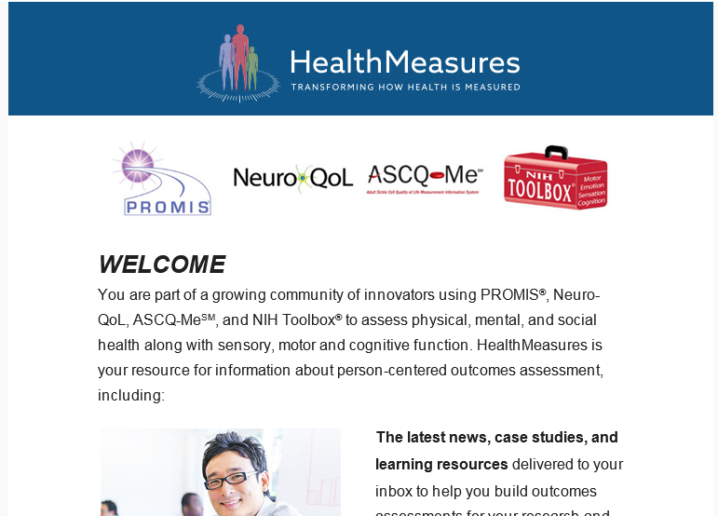
Join the HealthMeasures Listserv
Visit HealthMeasures.net or email help@healthmeasures.net to join!
Receive emails w/ newsletter, upcoming conferences and educational events about NIH Toolbox
HealthMeasures.net

Slide 17
Acknowledgments
Funding for HealthMeasures was provided by the National Institutes of Health grant U2C CA186878.
NIH Toolbox, NIH Toolbox for the Assessment of Neurological and Behavioral Function, PROMIS, Patient-Reported Outcomes Measurement Information System, ASCQ-Me, Adult Sickle Cell Quality of Life Measurement Information System, and their marks are owned by the U. S. Department of Health and Human Services.
HealthMeasures.net

