Slide 1
Introduction to Neuro-QoL
[Presenter Name]
[Event]
[Date]

Slide 2
What is Neuro-QoL™?
Quality of Life in Neurological Disorders
Measurement system that evaluates and monitors the physical, mental, and social effects experienced by adults and children living with neurological conditions
Developed & validated for common neurological conditions using state-of-the-science psychometric methods
Measures designed to be completed in approximately one minute
Translations available in Spanish and other languages
Supported by HealthMeasures, the official information & distribution center for 4 NIH-supported measurement systems (PROMIS®, Neuro-QoL™, ASCQ-Me® and NIH Toolbox®)
HealthMeasures.net/Neuro-QoL

Slide 3
Components of Neuro-QoL
DOMAIN
The feeling, function, or perception you wish to measure
Cuts across different diseases and settings, e.g., mobility, depressive symptoms
ITEM BANK
Collection of items that each measure the same domain
Use to create different measure types, all producing a score on the same metric
HealthMeasures.net/Neuro-QoL

Slide 4
Neuro-QoL Measure Types
Short Forms
Subsets of item banks
Computer Adaptive Tests (CATs)
Individually tailored electronic questionnaires
Uncalibrated
Item Pools
Untested item pools
Focused on a single domain
Off the shelf or custom
Usually 4-10 items
Focused on a single domain
Next item administered from item bank depends on previous answers
Usually 4-12 items
Use a raw summary score
Available for further measure development
HealthMeasures.net/Neuro-QoL

Slide 5
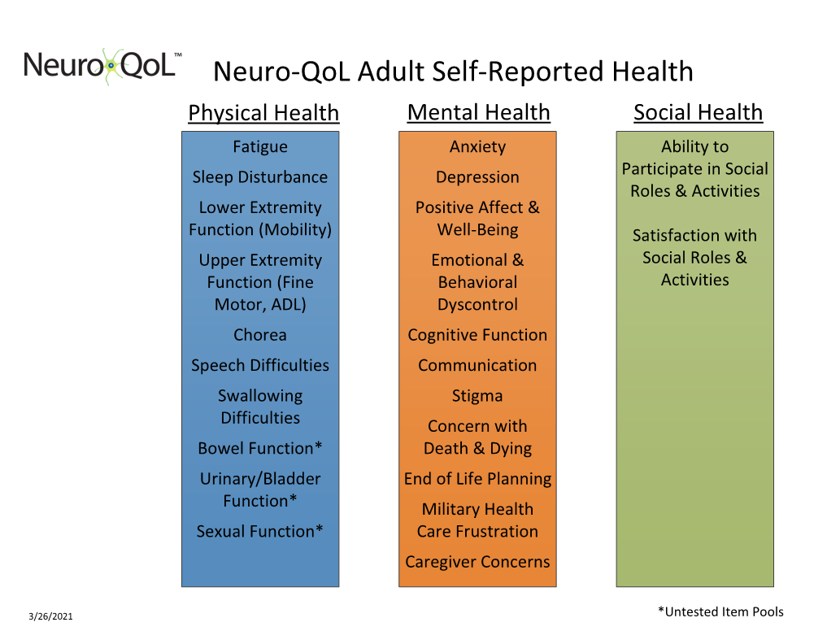
Domains for Adult Assessment
HealthMeasures.net/Neuro-QoL

Slide 6
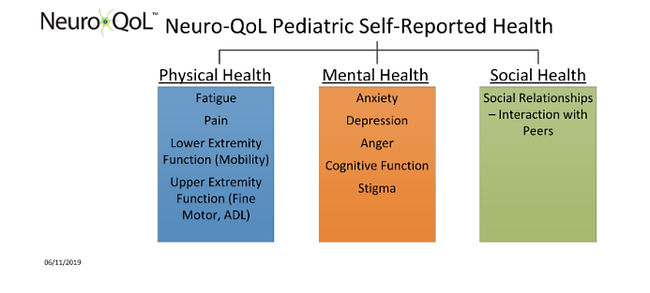
Domains for Pediatric Assessment
HealthMeasures.net/Neuro-QoL

Slide 7
Based on Item Response Theory (IRT)
Assumes an individual’s responses to items are related to an unobservable domain or trait (e.g. fatigue). IRT can use item responses to estimate a person’s score on that domain, or expected responses to different items can be estimated from a person’s score.
“I was too tired to leave the house”
Never | Always
Energetic
Severe
FATIGUE
HealthMeasures.net/Neuro-QoL

Slide 8
Select, Obtain and Administer Neuro-QoL Measures
HealthMeasures.net/Neuro-QoL

Slide 9

Neuro-QoL is at HealthMeasures.net
Official information & distribution center for PROMIS, Neuro-QoL, NIH Toolbox & ASCQ-Me
Search & View Measures: Download free, respondent- ready PDFs of Neuro-QoL measures. Many measures available, all searchable by domain, preferred measure type, language, and more.
Explore Measurement Systems:
Free guides to help you select Neuro-QoL measures for specific uses or patient populations (e.g., stroke)
HealthMeasures.net/Neuro-QoL

Slide 10
Administration & Data Collection
Respondent-ready PDFs for short forms and profiles on HealthMeasures.net
Using a Computer
Required for administration of CATs
Using Paper
Minimal technology needed; staff time required for data entry and scoring
Neuro-QoL measures are available in REDCap and can be added to the Epic PROMIS CAT application via request.
For a custom solution, the HealthMeasures API allows your data collection system to administer Neuro-QoL measures (including CATs)
Using the PROMIS or NIH Toolbox iPad App
Select Neuro-QoL CATs and short forms are available for administration through both the PROMIS and NIH Toolbox Apps
Available in the iTunes Store
HealthMeasures.net/Neuro-QoL

Slide 11
Proxy Respondents
A parent or caregiver can complete a pediatric or adult Neuro-QoL measure when needed with the instructions:
INSTRUCTIONS FOR PARENTS
“The following questionnaires will ask about your child’s symptom and activity levels; his/her ability to think, concentrate and remember things; questions specific to his/her condition, and questions related to his/her quality of life. Please answer the following questions based on what you think your child would say.”
HealthMeasures.net/Neuro-QoL

Slide 12
Score and Interpret Neuro-QoL Measures
HealthMeasures.net/Neuro-QoL

Slide 13
Neuro-QoL Scoring Options
HealthMeasures Scoring Service
Free, web-based application
Automatic Scoring via Administration Platform
Many data collection tools such as REDCap automatically score responses & deliver results
By Hand
The Scoring Manual provides details and instructions for scoring individual Neuro-QoL measures
Receive scored file by email
Most accurate and preferred method for calculating scores
Accessed using the Search & View Measures feature and Scoring Instructions page on HealthMeasures.net
HealthMeasures.net/Neuro-QoL

Slide 14
Understanding Neuro-QoL Scores
Neuro-QoL measures use a T-score metric
  50 is the mean of a relevant reference population
  10 is the standard deviation (SD) of that population
Meaning of the score is defined by how it compares to the scores of others in a reference population
High scores equal more of the domain being measured (e.g., more fatigue, more mobility)
HealthMeasures.net/Neuro-QoL

Slide 15
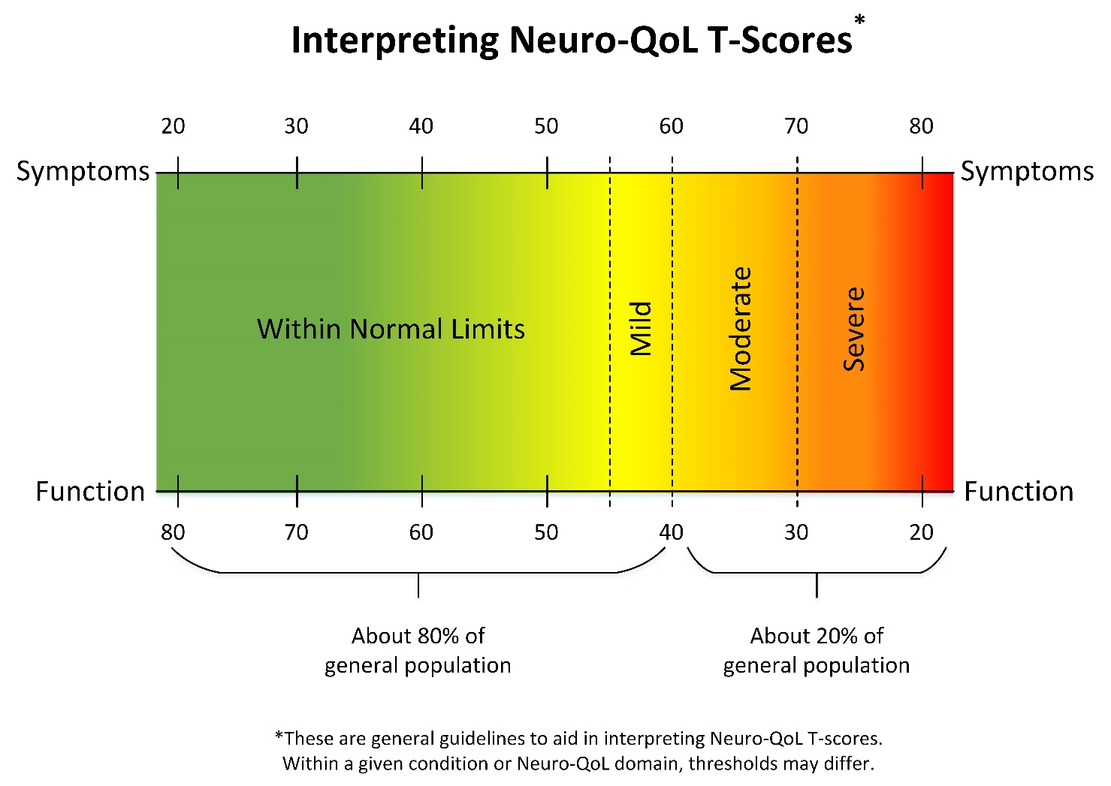
Neuro-QoL Score Ranges
HealthMeasures.net/Neuro-QoL

Slide 16
Neuro-QoL at Work
HealthMeasures.net/Neuro-QoL

Slide 17
Examples of Neuro-QoL at Work in Clinical Practice & Quality of Care
Cleveland Clinic:
  iPad assessments administered in Multiple Sclerosis Partners Advancing Technology and Health Solutions (MS-PATH) centers
  Neuro-QoL measures self-administered prior to appointments and longitudinally document each patient’s trajectory on relevant health-related quality of life outcomes
National Quality Forum:
  Developed Neuro-QoL-based quality measure in collaboration with American Academy of Neurology with Biogen funding
HealthMeasures.net/Neuro-QoL
Notes:
¹ http://www.neurology.org/content/82/10_Supplement/P2.116

Slide 18
Examples of Neuro-QoL at Work in Clinical Research
Northwestern Medicine:
  Neuro-QOL measures were superior to the Modified Rankin Scale (MRS) when assessing post-stroke cognitive function
Parkinson Study Group and Massachusetts General Hospital:
  Multi-center randomized controlled trial using Neuro-QoL Depression in patients with Parkinson’s Disease
National Institute of Nursing Research:
  Validating Neuro-QoL measures in children with cerebral palsy and neuromuscular diseases, and parent proxies
HealthMeasures.net/Neuro-QoL
Notes:
² http://www.neurology.org/content/82/10_Supplement/P2.116
³ https://clinicaltrials.gov/ct2/show/study/NCT02642393
⁴https://clinicaltrials.gov/ct2/show/record/NCT02153970?outc=Neuro-QoL&rank=2

Slide 19
Acknowledgments
Funding for HealthMeasures was provided by the National Institutes of Health grant U2C CA186878.
ASCQ-Me, the Adult Sickle Cell Quality of Life Measurement Information System, PROMIS, Patient-Reported Outcomes Measurement Information System, NIH Toolbox for the Assessment of Neurological and Behavioral Function, and their logos are marks owned by the U. S. Department of Health and Human Services.
HealthMeasures.net

